Slide 1
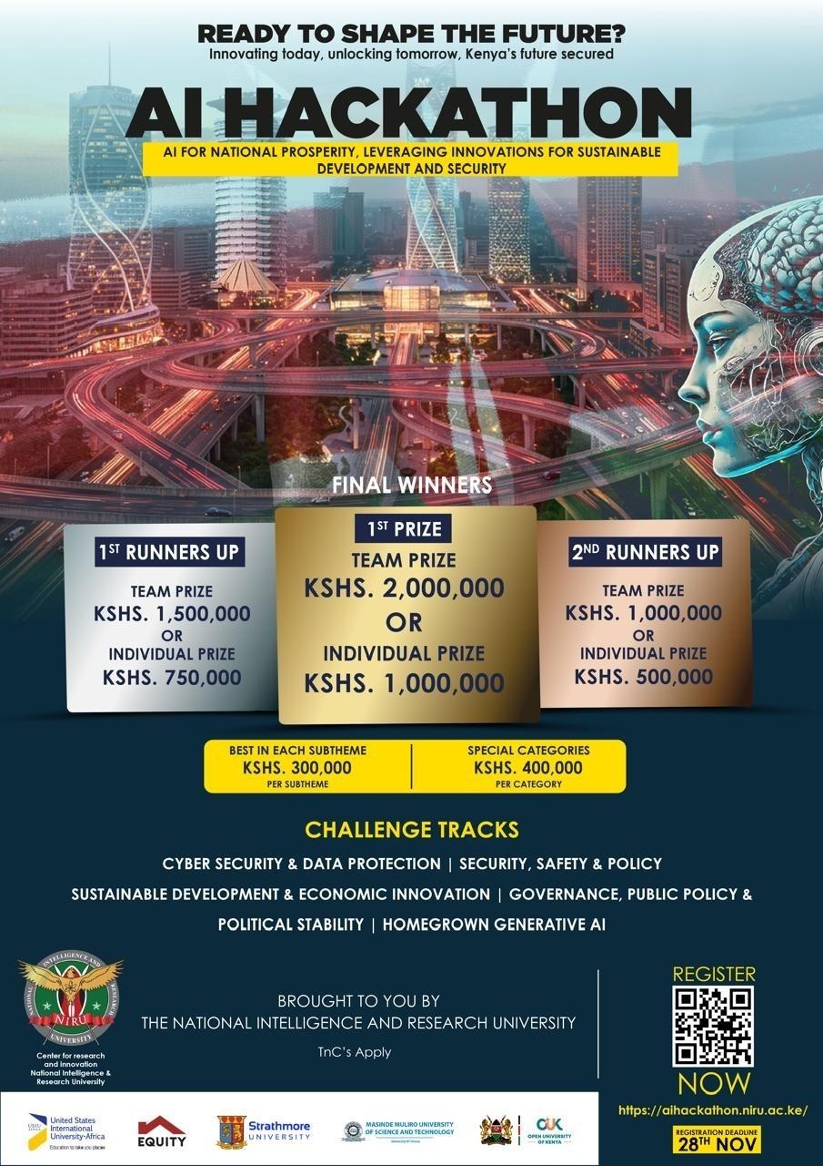

Slide 2
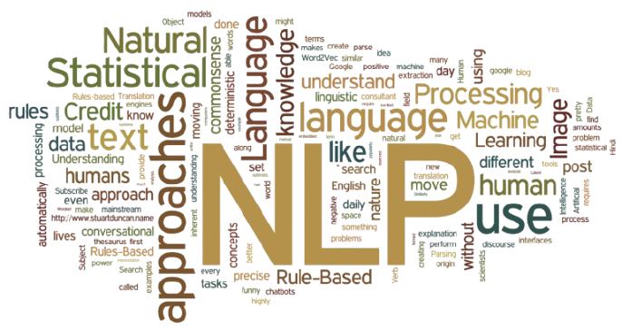
Democratizing NLP
Rogendo

Slide 3
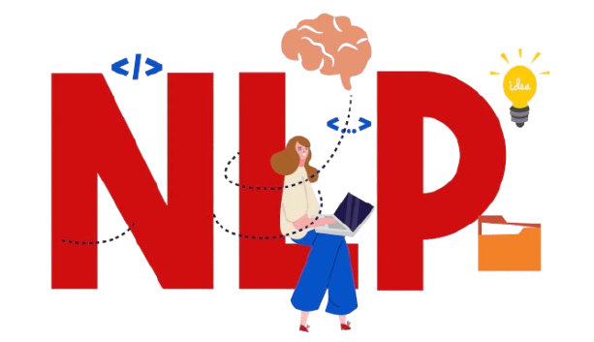

Agenda
NLP framework
Open Source
Sustainable Development
NLP Community

Slide 4
Problem Statement
While Silicon Valley builds billion-parameter models, Kenyan businesses struggle with basic NLP;
accustomed by Limited Data, Unaffordable Computational resource and skills costs.

Slide 5
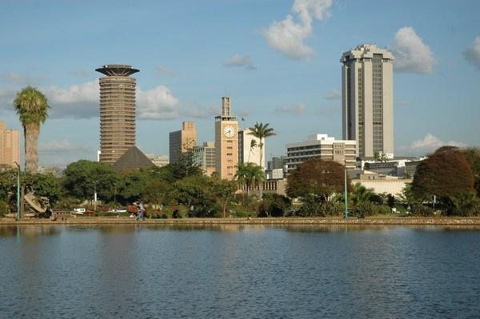
Kenya's national AI priorities

Slide 6
Sustainable Development
Goals
Priorities
Sustainable Development & Economic Innovation → Democratizing NLP = economic empowerment
Governance & Public Policy → Multi-task models for government document processing
Homegrown Generative AI → African-context aware language models
Cyber Security → Multi-task threat detection and classification
"National Prosperity" → Reduces AI costs 60-80%
"Leveraging Innovations" → Pre-trained models & Cutting-edge attention fusion techniques
"Security" → Multi-threat detection capabilities

Slide 7
NLP tasks
Base Models | Classification | Quality Assurance | Question Aswering | Summarization | Translation | NER | Sentiment Analysis
DistilBERT | ✅ Excellent | ✅ Good | ✅ Good | Extractive Only | ❌ Limited | ✅ Good | ✅ Excellent
BERT | ✅ Excellent | ✅ Good | ✅ Excellent | Extractive Only | ❌ Limited | ✅ Excellent | ✅ Excellent
RoBERTa | ✅ Excellent | ✅ Good | ✅ Excellent | Extractive Only | ❌ Limited | ✅ Excellent | ✅ Excellent
MT-Transformer | ✅ Excellent | ❌ Limited | ✅ Good | ✅ Abstractive | ✅ Excellent | ✅ Good | ✅ Good
XLM-RoBERTa | ✅ Excellent | ✅ Good | ✅ Excellent | ✅ Abstractive | ✅ Excellent | ✅ Excellent | ✅ Excellent
African BERT | ✅ Excellent | ✅ Good | ✅ Good | Extractive Only | ✅ African Langs | ✅ Excellent | ✅ Excellent
BART | ✅ Good | ✅ Good | ✅ Good | ✅ Excellent | ✅ Good | ❌ Limited | ✅ Good

Slide 8

An open-source Python framework that democratizes NLP development in Africa by reducing fine-tuning complexity and costs
Target Users: Developers, startups, researchers, government agencies

Slide 9
Our Product
It enables developers to:
Fine-tune BERT, DistilBERT, RoBERTa for ANY NLP task
Handle multilingual/multilabel/multiclass classification
Support translation, QA, QA/QC, NER, sentiment, summarization
Create custom data structures easily
Combine single tasks into multi-task models
African devs spend weeks setting up NLP experiments
No unified framework for multiple NLP tasks
Expensive computational resources
Western models don't understand local context
What we offer:
One framework for ALL NLP fine-tuning tasks
50% faster experimentation cycle
Built-in African language support
Open-source = $0 cost for startups

Slide 10
Winning Strategy
Prior
Open source
Community
Position as "Swahili & African Language Multi-Task AI Platform"
Emphasize cost reduction for Kenyan businesses/government
Highlight local context understanding
Show Individual Models - Train Swahili sentiment + NER models.
Demonstrate Fusion - Combine into a unified African-language model.
Live African Context - Process local news + government documents.
Open source the core codebase. Find alternative Business model.
Cool, easy to follow documentation and tutorials.
Using the power of Slack, Discord, Huggingface and bots, create a community.
Weekly blogs, and sharing of models, concepts, training scripts

Slide 11
Data Input
Custom Data Classes
Deployment
Model Selection
Task Configuration
Training

Slide 12
Timeline
Core framework MVP
Basic documentation
3 demo use cases
Full documentation website
10+ example notebooks
Discord community launch
Framework launch to pypi
Week 1
Week 2
Week 2
Week 3
Week 3

Slide 13
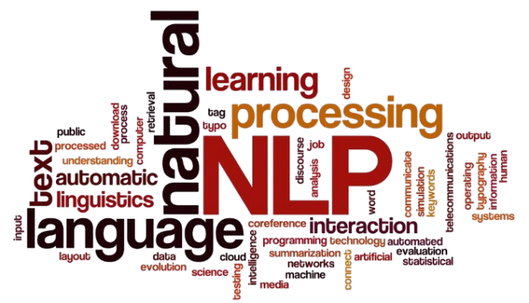
Summary
We’re not just entering a hackathon, we’re launching the foundation for Africa’s NLP ecosystem.
From healthcare to agriculture to governance, this framework enables African innovation across every sector.

Slide 14
Team
Kioko
Rogendo
Title
Title

Slide 15


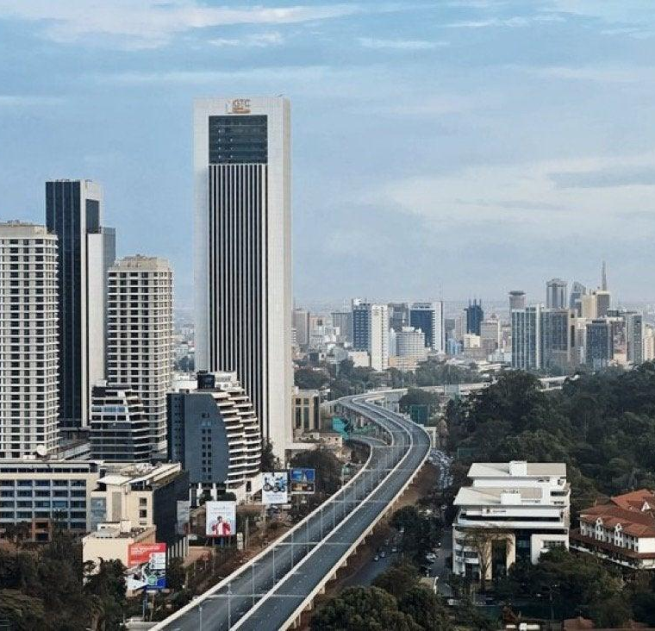
THANK YOU
Rogendo
rogendopeter@gmail.com

